Slide 1


NTDP Track: CSC
NTDP Core
Track Set Up
Pre-Class Data
Post-Class Data
VILT Week 1
VILT Week 2
Date Welcome Email Sent
M
Completed Post Assessment/EOC
P
Week 1: NTDP VILT Day 1
A
Week 2: NTDP VILT Day 1
F
Set Track Parameters
Attended Orientation Pre work
X
Completed NTDP Class?
Q
Week 1 NTDP VILT Day 2
B
Week 2: NTDP VILT Day 2
G
Set Track NTDP Track
Completed Pre-Assessment
N
Date NTDP Class Completed
R
Week 1: NTDP VILT Day 3
C
Week 2: NTDP VILT Day 3
K
W
H
Completed Pre-Work – Part 1
E
Reason Not Completing NTDP
Week 1: NTDP VILT Day 4
a
Week 2: NTDP VILT Day 4
Track Status
S
I
Completed PPA - Self Paced
N
TMS Credit Given
T
Save
Cancel
Completed Pre-Work – Part 2
O
Date Enrolled NTDP Course
G
VILT Week 3
VILT Week 4
X
Z
Org When Class Completed
S
Week 3: NTDP VILT Day 1
B
Week 4: NTDP VILT Day 1
Completed Pre-Work - Part 3
J
Save validation info here?
P
Completed Pre-work - Part 4
Q
Class Comments
Week 3: NTDP VILT Day 2
C
Week 4: NTDP VILT Day 2
Z
K
Week 3: NTDP VILT Day 3
D
Week 4: NTDP VILT Day 3
L
Week 3: NTDP VILT Day 4
E
Week 4: NTDP VILT Day 4
M
Track Set Up Notes
Track Set Up Notes

Slide 2
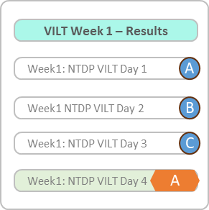
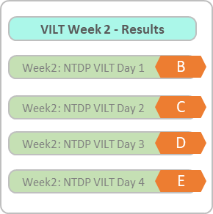
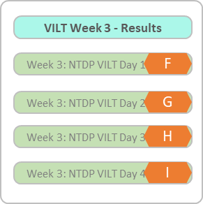
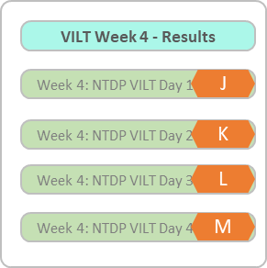
NTDP Track Set Up
NTDP Class Scheduler
Employee Class Assignment
Pre-Data
Course Data
Pre-Data
Date Welcome Email Sent
Date Welcome Email Sent
M
M
Attended Orientation/Pre work
Orientation and Pre-Work Start Date:
Attended Orientation/Pre-Work
D
Pre-Work End Date:
X
E
X
Completed Pre-Assessment
Pre-Test Open:
Completed Pre-Assessment
M
Pre-Test Close:
N
N
N
VILT Week 1 End Date:
VILT Week 1 Start Date:
G
F
Completed Pre-Work Part 1
Completed Pre-Work – Part 1
E
E
Completed PPA - Self Paced
N
PPA - Self Paced Start Date
PPA - Self Paced End Date
Completed PPA - Self Paced
N
O
Pre-Work Part 2 End Date
Completed Pre-Work – Part 2
Completed Pre-Work – Part 2
Pre-Work Part 2 Start Date
O
VILT Week 2 Start Date:
VILT Week 2 End Date:
H
I
Completed Pre-Work Part 3
P
Pre-Work Part 3 Start Date
Pre-Work Part 3 End Date
Completed Pre-Work - Part 3
P
X
VILT Week 3 End Date:
VILT Week 3 Start Date:
Completed Pre-Work Part 4
Q
Completed Pre-Work - Part 4
Pre-Work Part 4 Start Date
Pre-Work Part 4 End Date
Q
VILT Week 4 Start Date:
VILT Week 4 End Date:
Z

Slide 3
NTDP Track Set Up
NTDP Class Scheduler
Employee Class Assignment
Post-Data
Course Data
Post-Data
Completed Post Assessment/EOC
Post-Test/EOC Open:
Completed Post Assessment/EOC
O
Post-Test/EOC Close:
P
P
Z
P
Completed NTDP?
Completed NTDP?
Q
Q
Date NTDP Course Completed
Date NTDP Course Completed
R
R
Reason Not Completing NTDP
Reason Not Completing NTDP
S
S
TMS Credit Given
TMS Credit Given
T
T
Date Enrolled NTDP Course
Date Enrolled NTDP Course
G
G
Org When Course Completed
Org When Course Completed
S
Course Comments
Course Comments
Z
Z

Slide 4
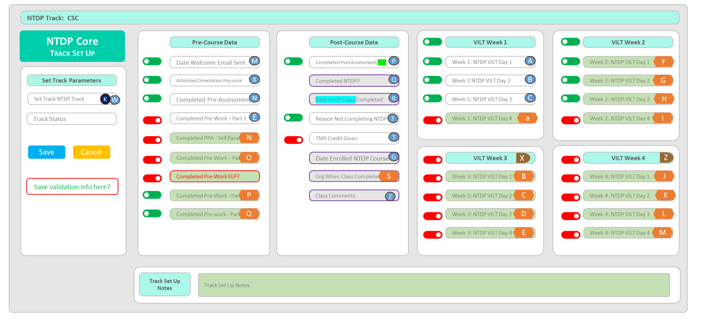
Add NTDP Core – Track Set Up form
Role:
Part 1: Add Track Set Up form
Add Course Data Entry form = Big outer container
Light grey background with Light grey border
Add Tab Form Header container = If active = light green spans top of form
Bold Black font, left justify
Label = NTDP Track: Display Track
Part 2: Add Form Label
Add Form Label -- Above the container
Dark Green background, Bold white text
Label =
Top row = NTDP Core
Row 2 = Track Set Up (small caps)
Part 3: Add container – Track Status
Add top container = White background with thin light grey border
Add container header
Light green w/thin light grey border
Black bold text = Set Track Parameters
Same field = NTDP Track (required)
Db = InstructorTrack
NEW field = Track Status (required)
Draft
Active
Inactive
Add button = Save
Save all items in the form
Add Button = Cancel
No items are saved
Add save validation

Slide 5
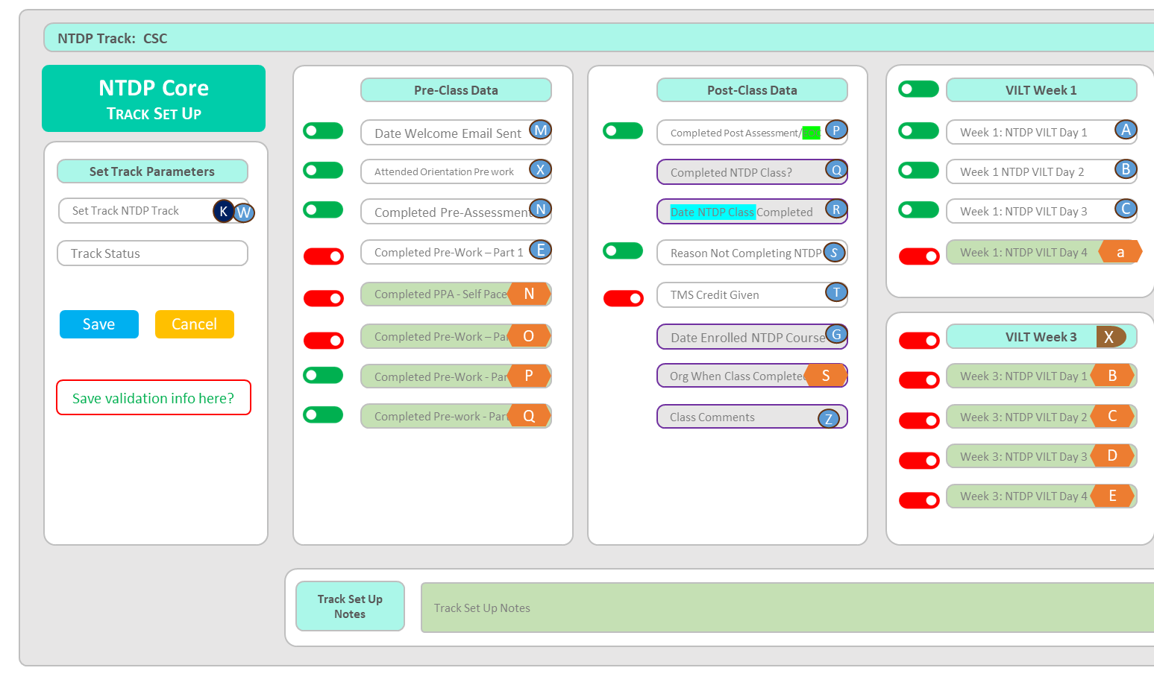
Add NTDP Core – Track Set Up form
Role:
The Track Set Up form allows the user to configure the fields to display in a Track. By setting the toggle to yes, that specific toggle will display specific fields in both the Class Scheduler and the Employee Assignment forms.
Part 1: Add container – Pre-Class Data
Add top container = White background with thin light grey border
Add container header
Light green w/thin light grey border
Black bold text = Set Pre-Class Data
Add toggle = existing field = Date Welcome Email Sent
Add toggle = existing field = Attended Orientation Pre work
Add toggle = existing field = Completed Pre-Assessment
Add toggle = existing field = Completed Pre-Work – Part 1
Add toggle = NEW field = Completed PPA - Self Paced
Add toggle = NEW field = Completed Pre-Work – Part 2
Add toggle = NEW field = Completed Pre-Work - Part 3
Add toggle = NEW field = Completed Pre-Work - Part 4
Part 2: Add container – Track Set Up Notes
Add top container = White background with thin light grey border
Add container header
Light green w/thin light grey border
Black bold text = Track Set Up Notes
New field = 300 characters
Slide 1
Slide 2,3,4
What is required when?

Slide 6

Add NTDP Core – Track Set Up form
Role:
The Track Set Up form allows the user to configure the fields to display in a Track. By setting the toggle to yes, that specific toggle will display specific fields in both the Class Scheduler and the Employee Assignment forms.
Part 1: Add container – Post-Class Data
Add top container = White background with thin light grey border
Add container header
Light green w/thin light grey border
Black bold text = Set Post-Class Data
Add toggle = existing field = Completed Post Assessment/EOC
Add toggle = existing field = Completed NTDP Class?
Add toggle = existing field = Date NTDP Class Completed
Add toggle = existing field = Reason Not Completing NTDP
Add toggle = existing field = TMS Credit Given
Add toggle = existing field = Date Enrolled NTDP Course
Add toggle = NEW field = Org When Class Completed
Add toggle = existing field = Class Comments
Slide 1,2
Slide 4

Slide 7
Add NTDP Core – Track Set Up form
Role:
The Track Set Up form allows the user to configure the fields to display in a Track. By setting the toggle to yes, that specific toggle will display specific fields in both the Class Scheduler and the Employee Assignment forms.
Part 1: Add container – VILT Week 1
Add top container = White background with thin light grey border
Add container header
Light green w/thin light grey border
Black bold text = VILT Week 1
Add toggle = existing field = Week 1: NTDP VILT Day 1
Add toggle = existing field = Week 1 NTDP VILT Day 2
Add toggle = existing field = Week 1: NTDP VILT Day 3
Add toggle = NEW field = Week 1: NTDP VILT Day 4
Part 3: Add container – VILT Week 3
Add top container = White background with thin light grey border
Add container header
Light green w/thin light grey border
Black bold text = VILT Week 3
Add toggle = NEW field = Week 3: NTDP VILT Day 1
Add toggle = NEW field = Week 3: NTDP VILT Day 2
Add toggle = NEW field = Week 3: NTDP VILT Day 3
Add toggle = NEW field = Week 3: NTDP VILT Day 4
Slide 1,2,3
Slide 5

Slide 8
Add NTDP Core – Track Set Up form
Role:
The Track Set Up form allows the user to configure the fields to display in a Track. By setting the toggle to yes, that specific toggle will display specific fields in both the Class Scheduler and the Employee Assignment forms.
Part 1: Add container – VILT Week 2
Add top container = White background with thin light grey border
Add container header
Light green w/thin light grey border
Black bold text = VILT Week 2
Add toggle = NEW field = Week 2: NTDP VILT Day 1
Add toggle = NEW field = Week 2 NTDP VILT Day 2
Add toggle = NEW field = Week 2: NTDP VILT Day 3
Add toggle = NEW field = Week 2: NTDP VILT Day 4
Part 3: Add container – VILT Week 4
Add top container = White background with thin light grey border
Add container header
Light green w/thin light grey border
Black bold text = VILT Week 4
Add toggle = NEW field = Week 4: NTDP VILT Day 1
Add toggle = NEW field = Week 4: NTDP VILT Day 2
Add toggle = NEW field = Week 4: NTDP VILT Day 3
Add toggle = NEW field = Week 4: NTDP VILT Day 4
Slide 1,2,3,4

Slide 9
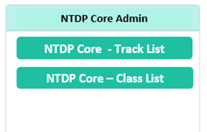
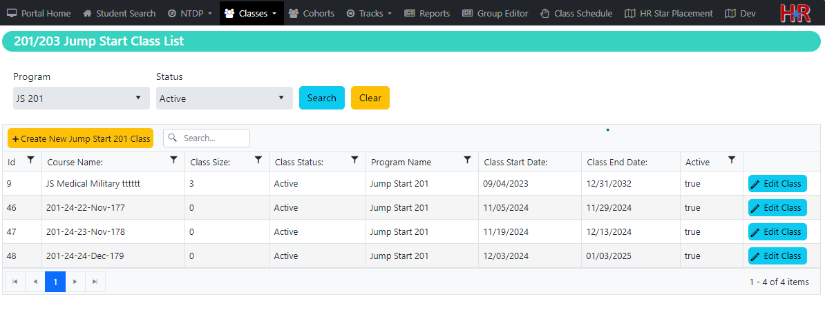
Add NTDP Core – Track Set Up - Search Page
Role: NTDP Admin
Part 1: Add search filters
Add page header =
Label = NTDP Core – Track Set Up
Dark green with white font, bold
Add filter = NTDP Core Track
Dropdown
Select (displays all tracks) default
List individual tracks
Add button = Search
Add Button = Clear
Part 2: Add display grid
Add Button = Create New NTDP Core Track
Gold background, blank font = This opens the Class Scheduler data entry form
Add Results Grid
Add column = Track ID
Add column = Track Name
Add column = Track Status
Add button = Edit Track
Opens specific Track Set Up Form
search
NTDP Core – Track Set Up
NTDP Core Track
Create New NTDP Core Track
Track ID
Track Name
Track Status
Track
Edit
Edit

